Slide 1

Falling in Love with CTFs
Lessons from Shellphish in Love and Loss
Zion Leonahenahe Basque
(@mahaloz)

Slide 2
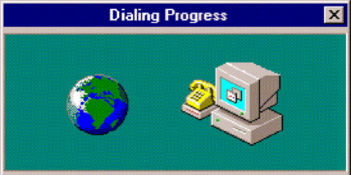
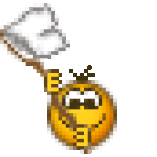
CTFs
Challenges
You

Slide 3
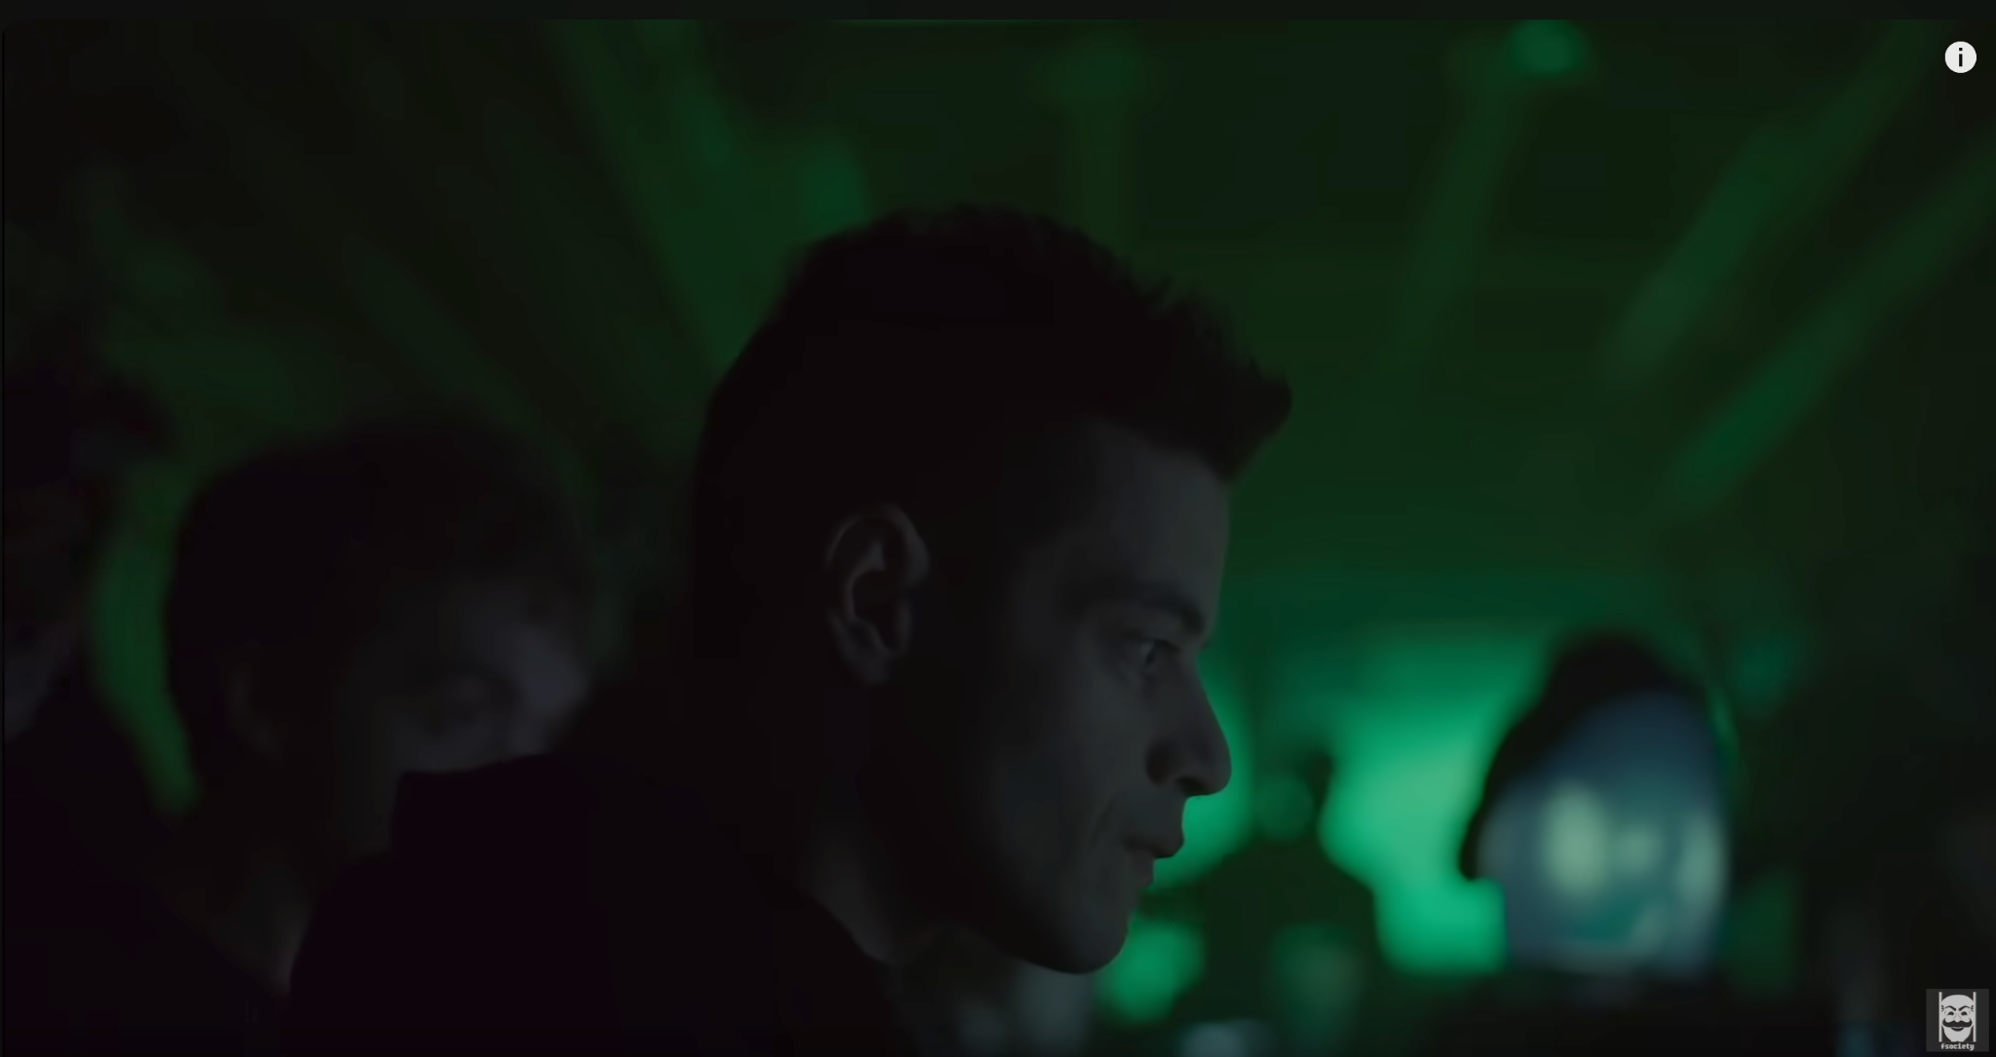
CTFs: Media

Slide 4
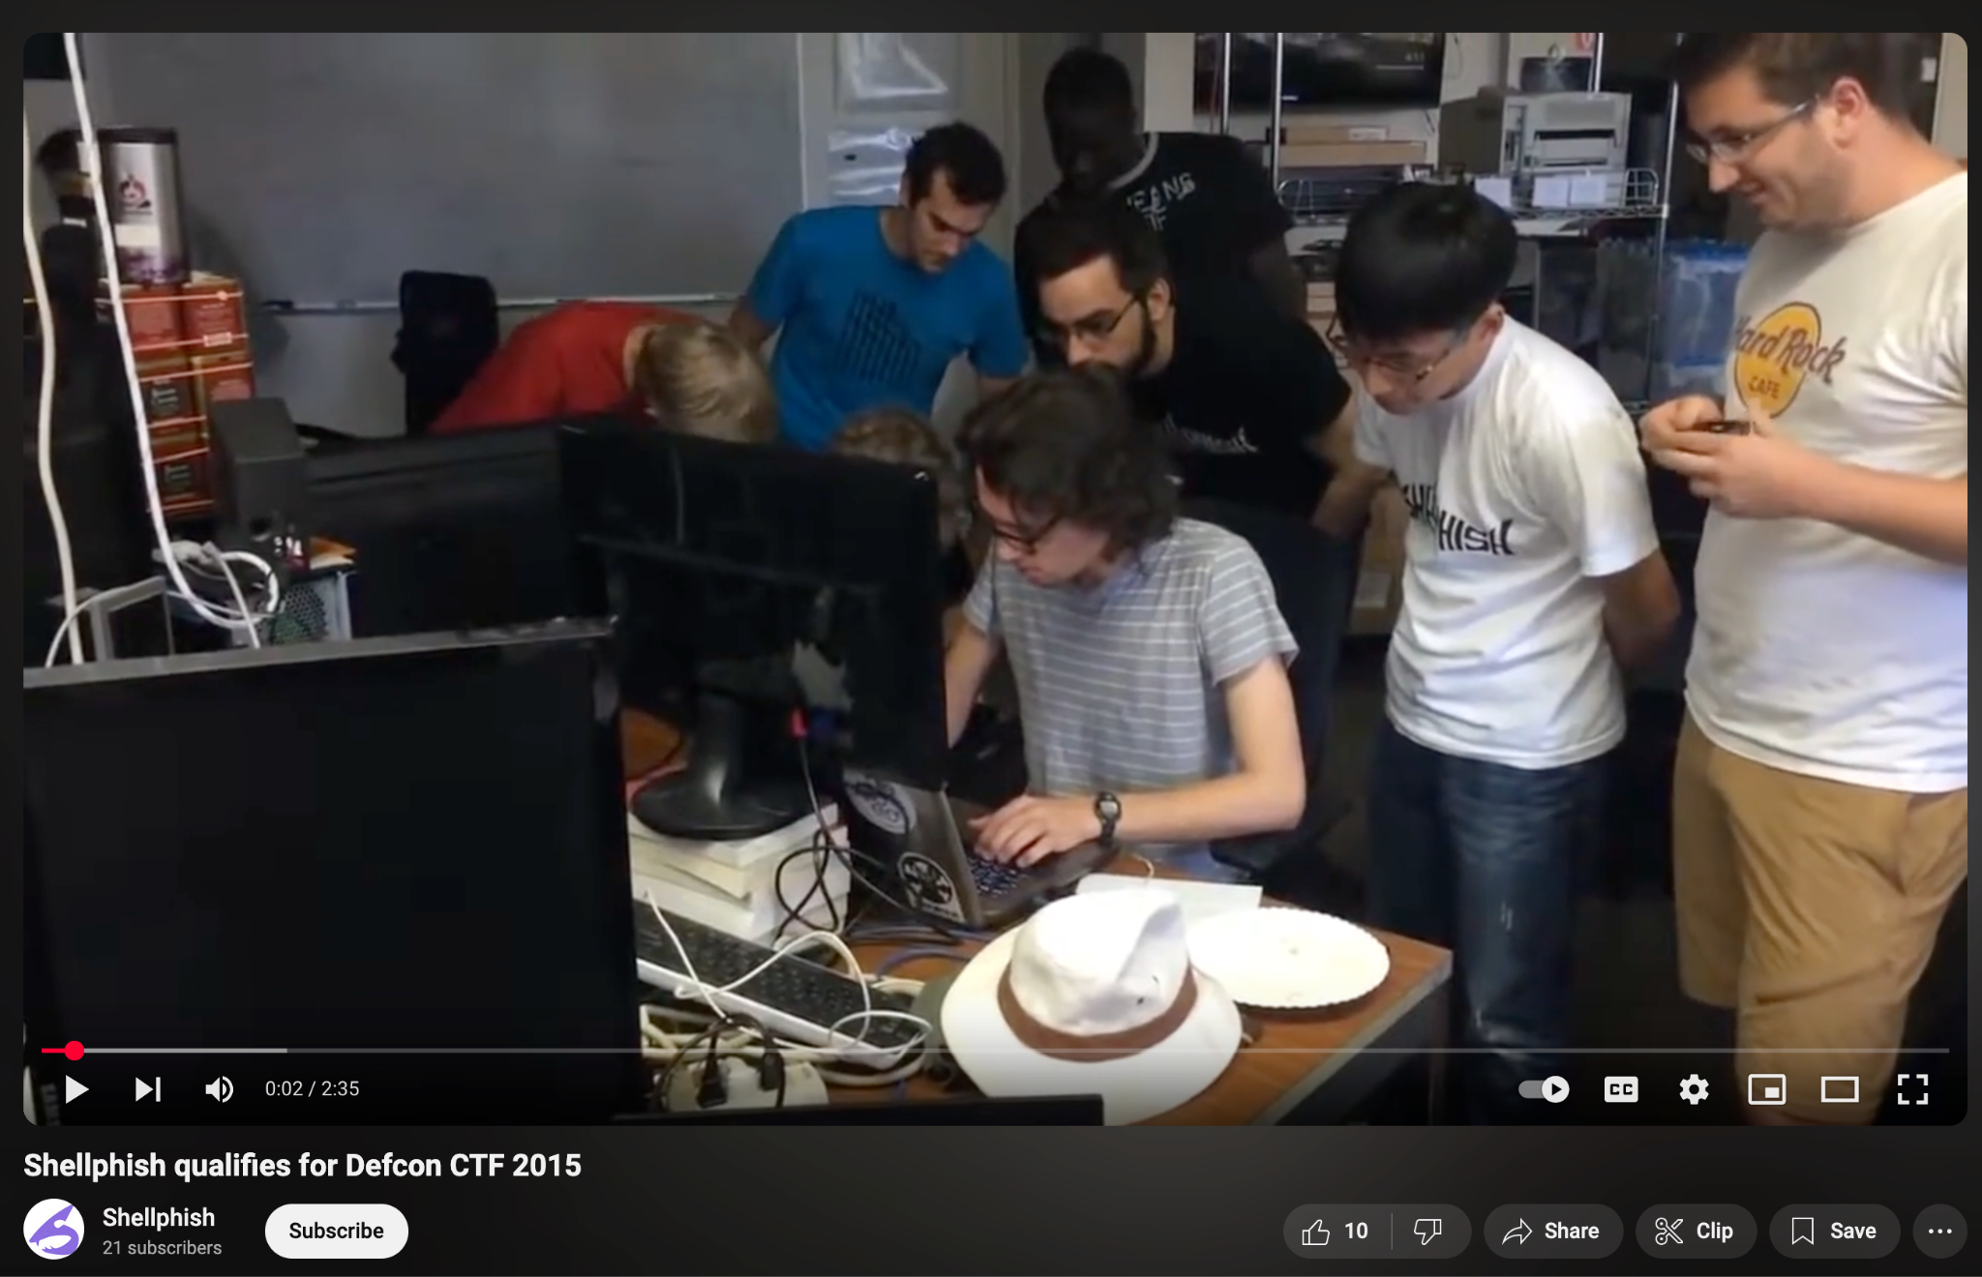
CTFs: Reality

Slide 5
So, are CTFs still cool?

Slide 6
YES

Slide 7
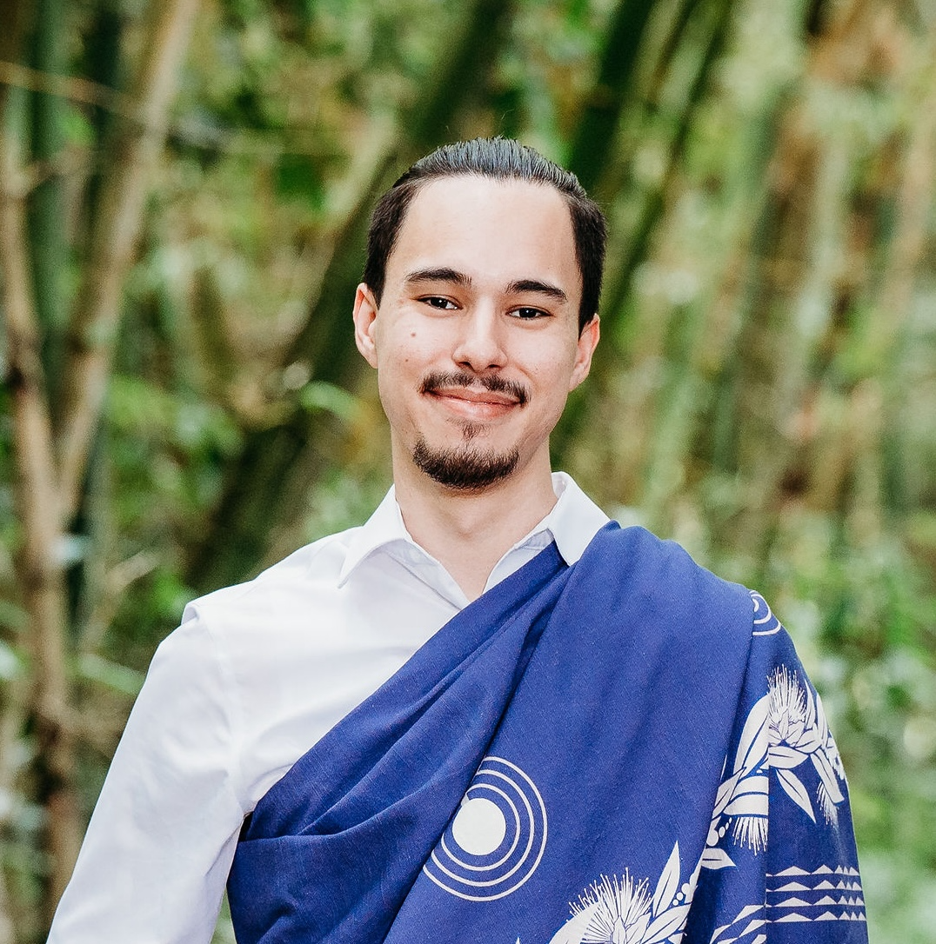
Your CTF Relationship Guide

Slide 8
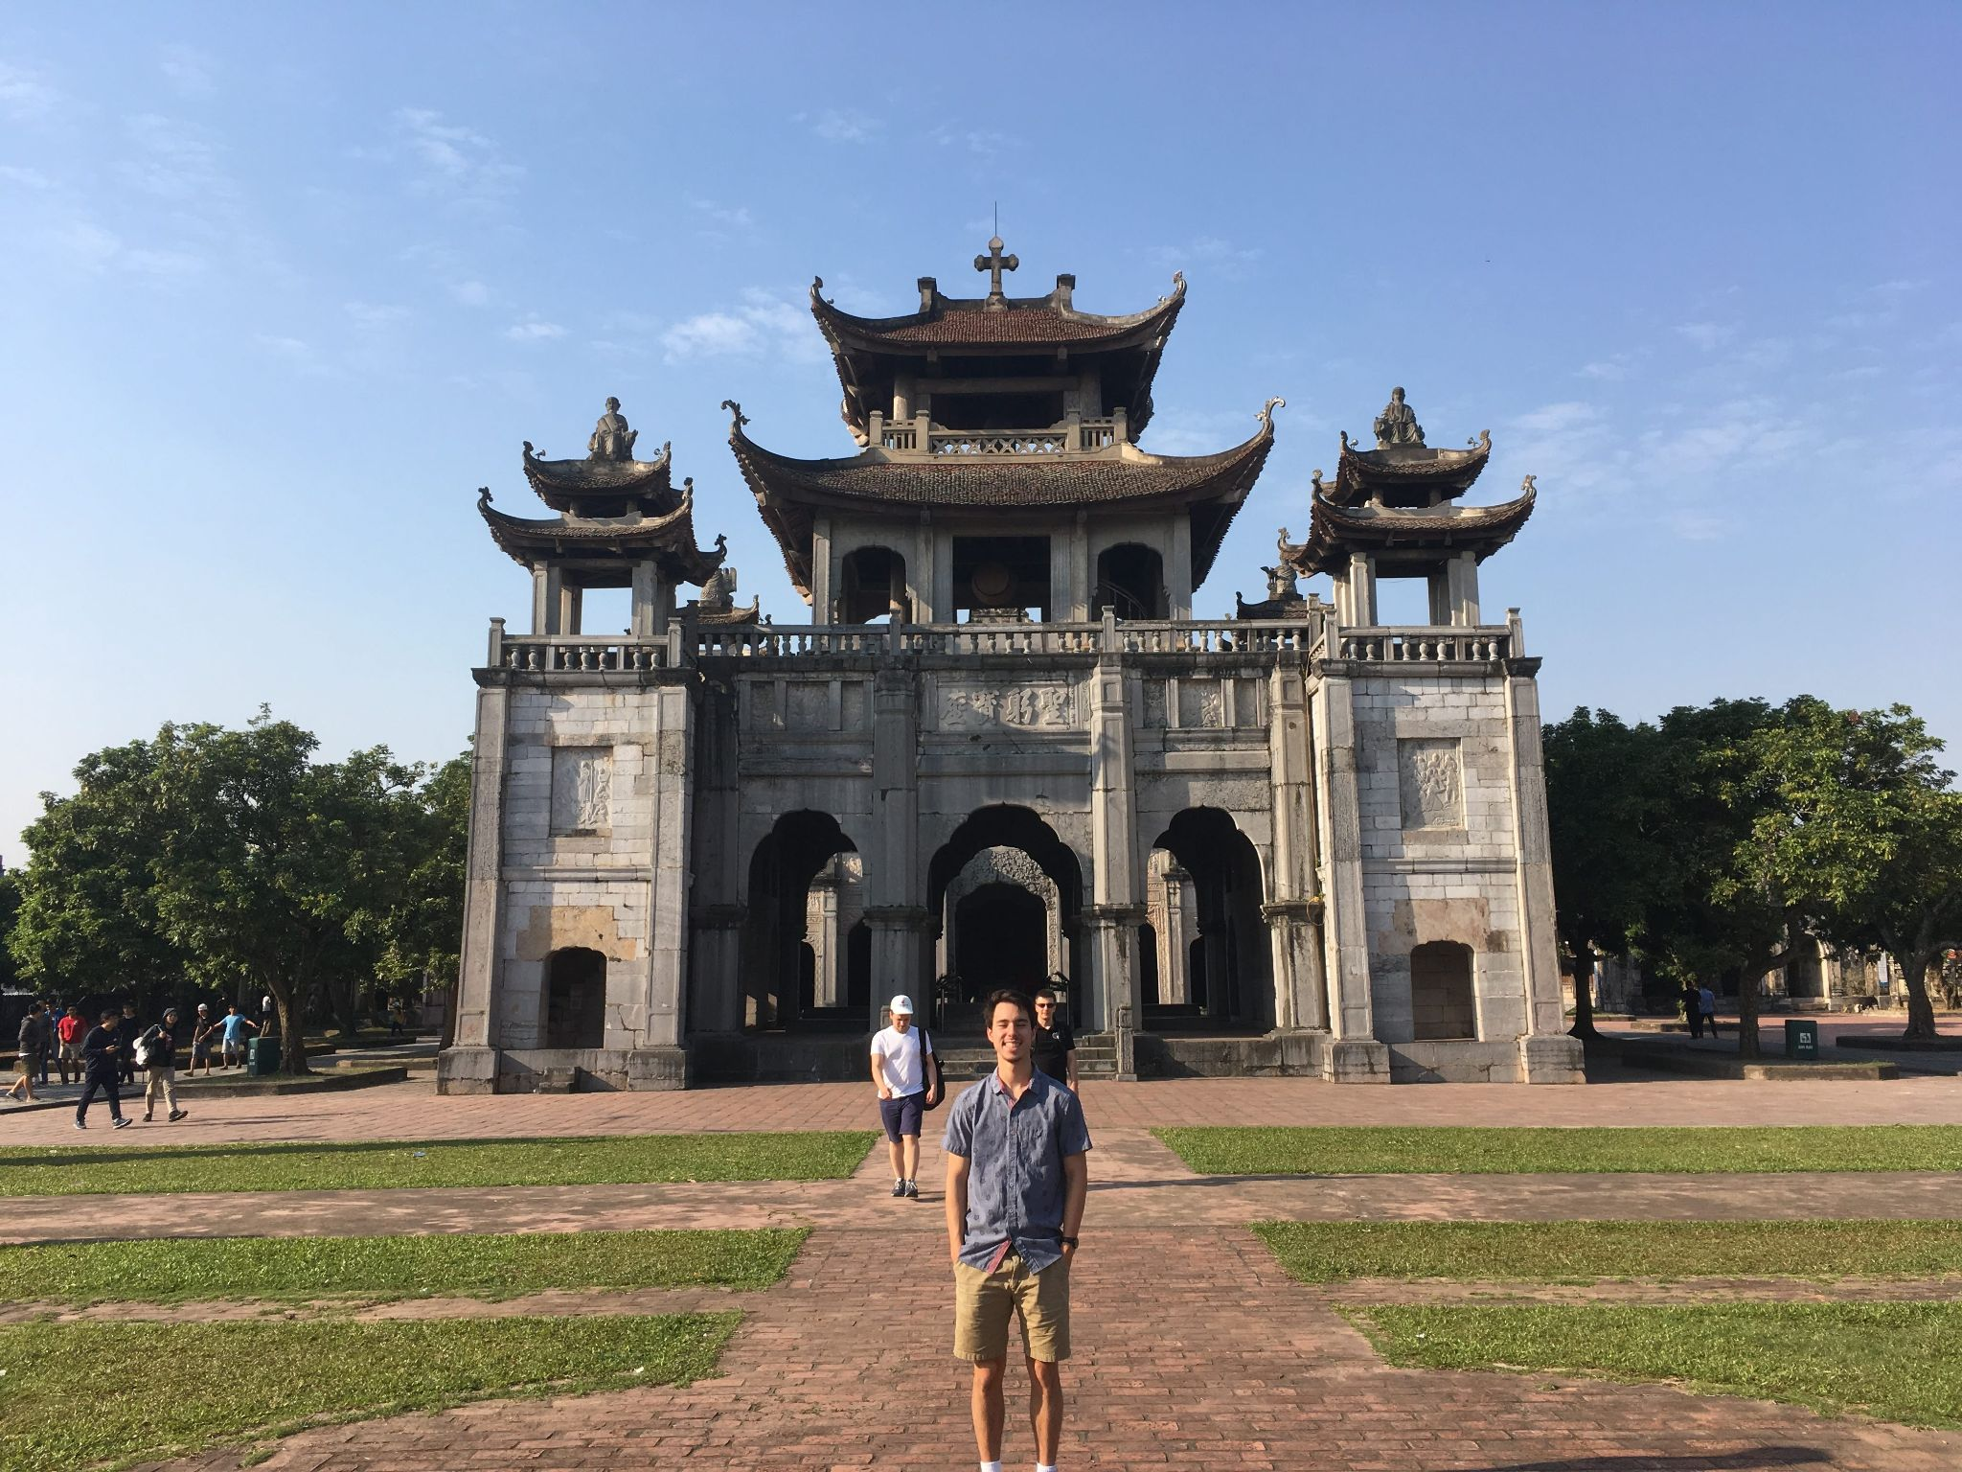
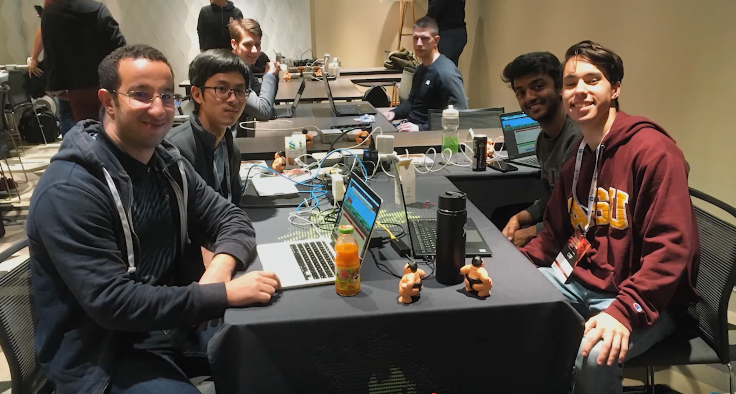
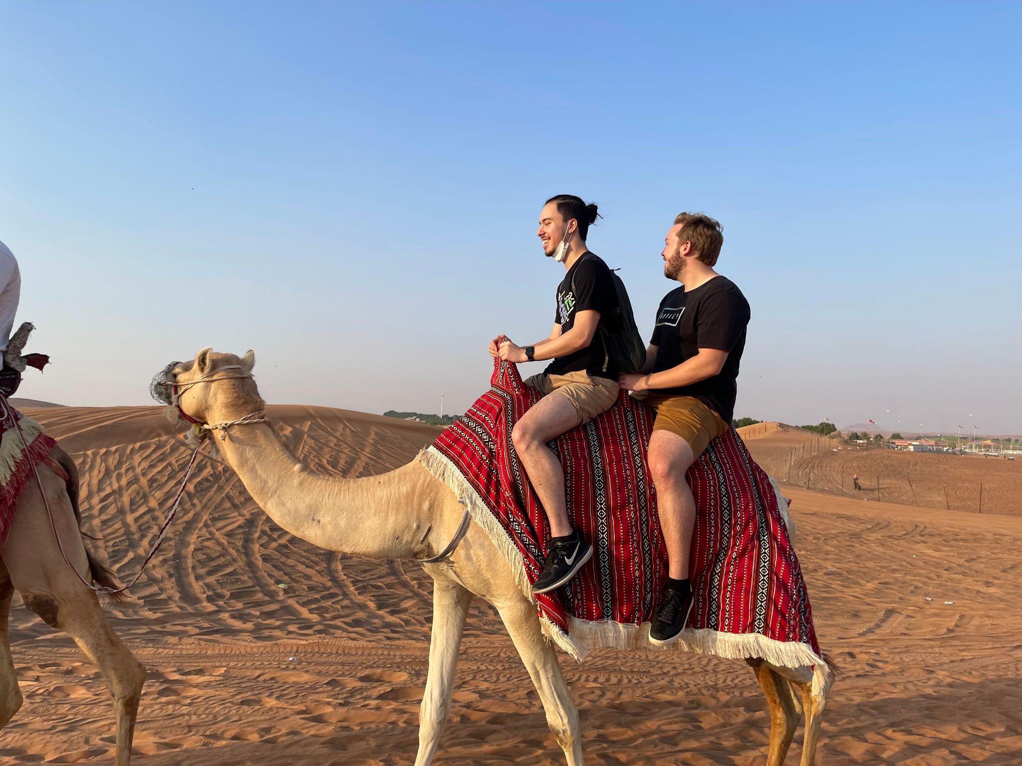
Your CTF Relationship Guide

Slide 9
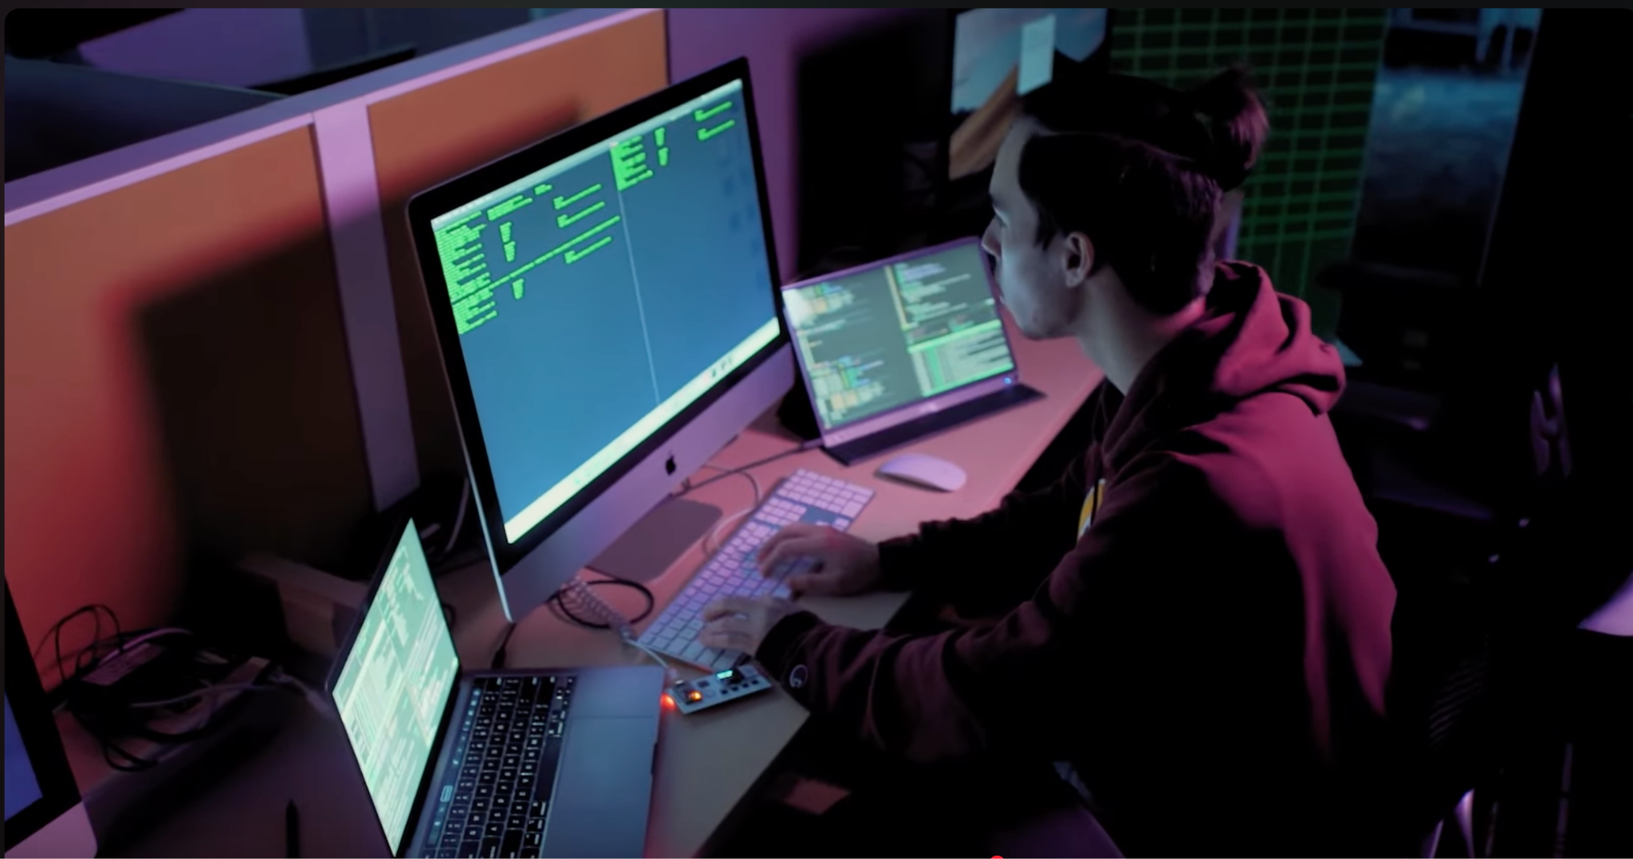
Your CTF Relationship Guide

Slide 10
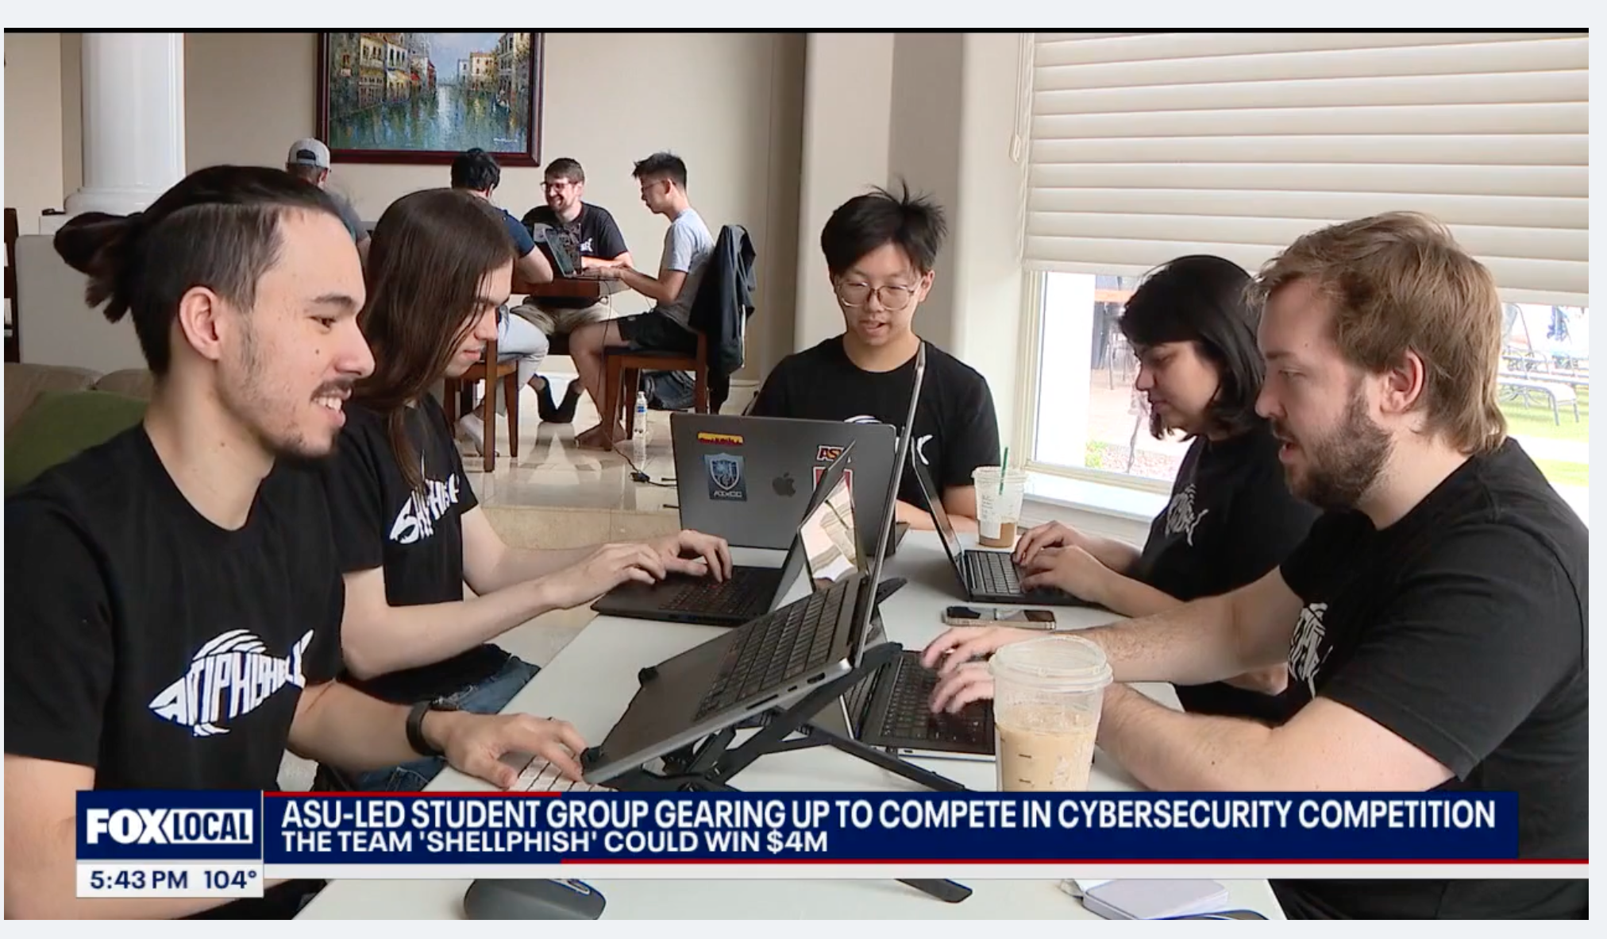
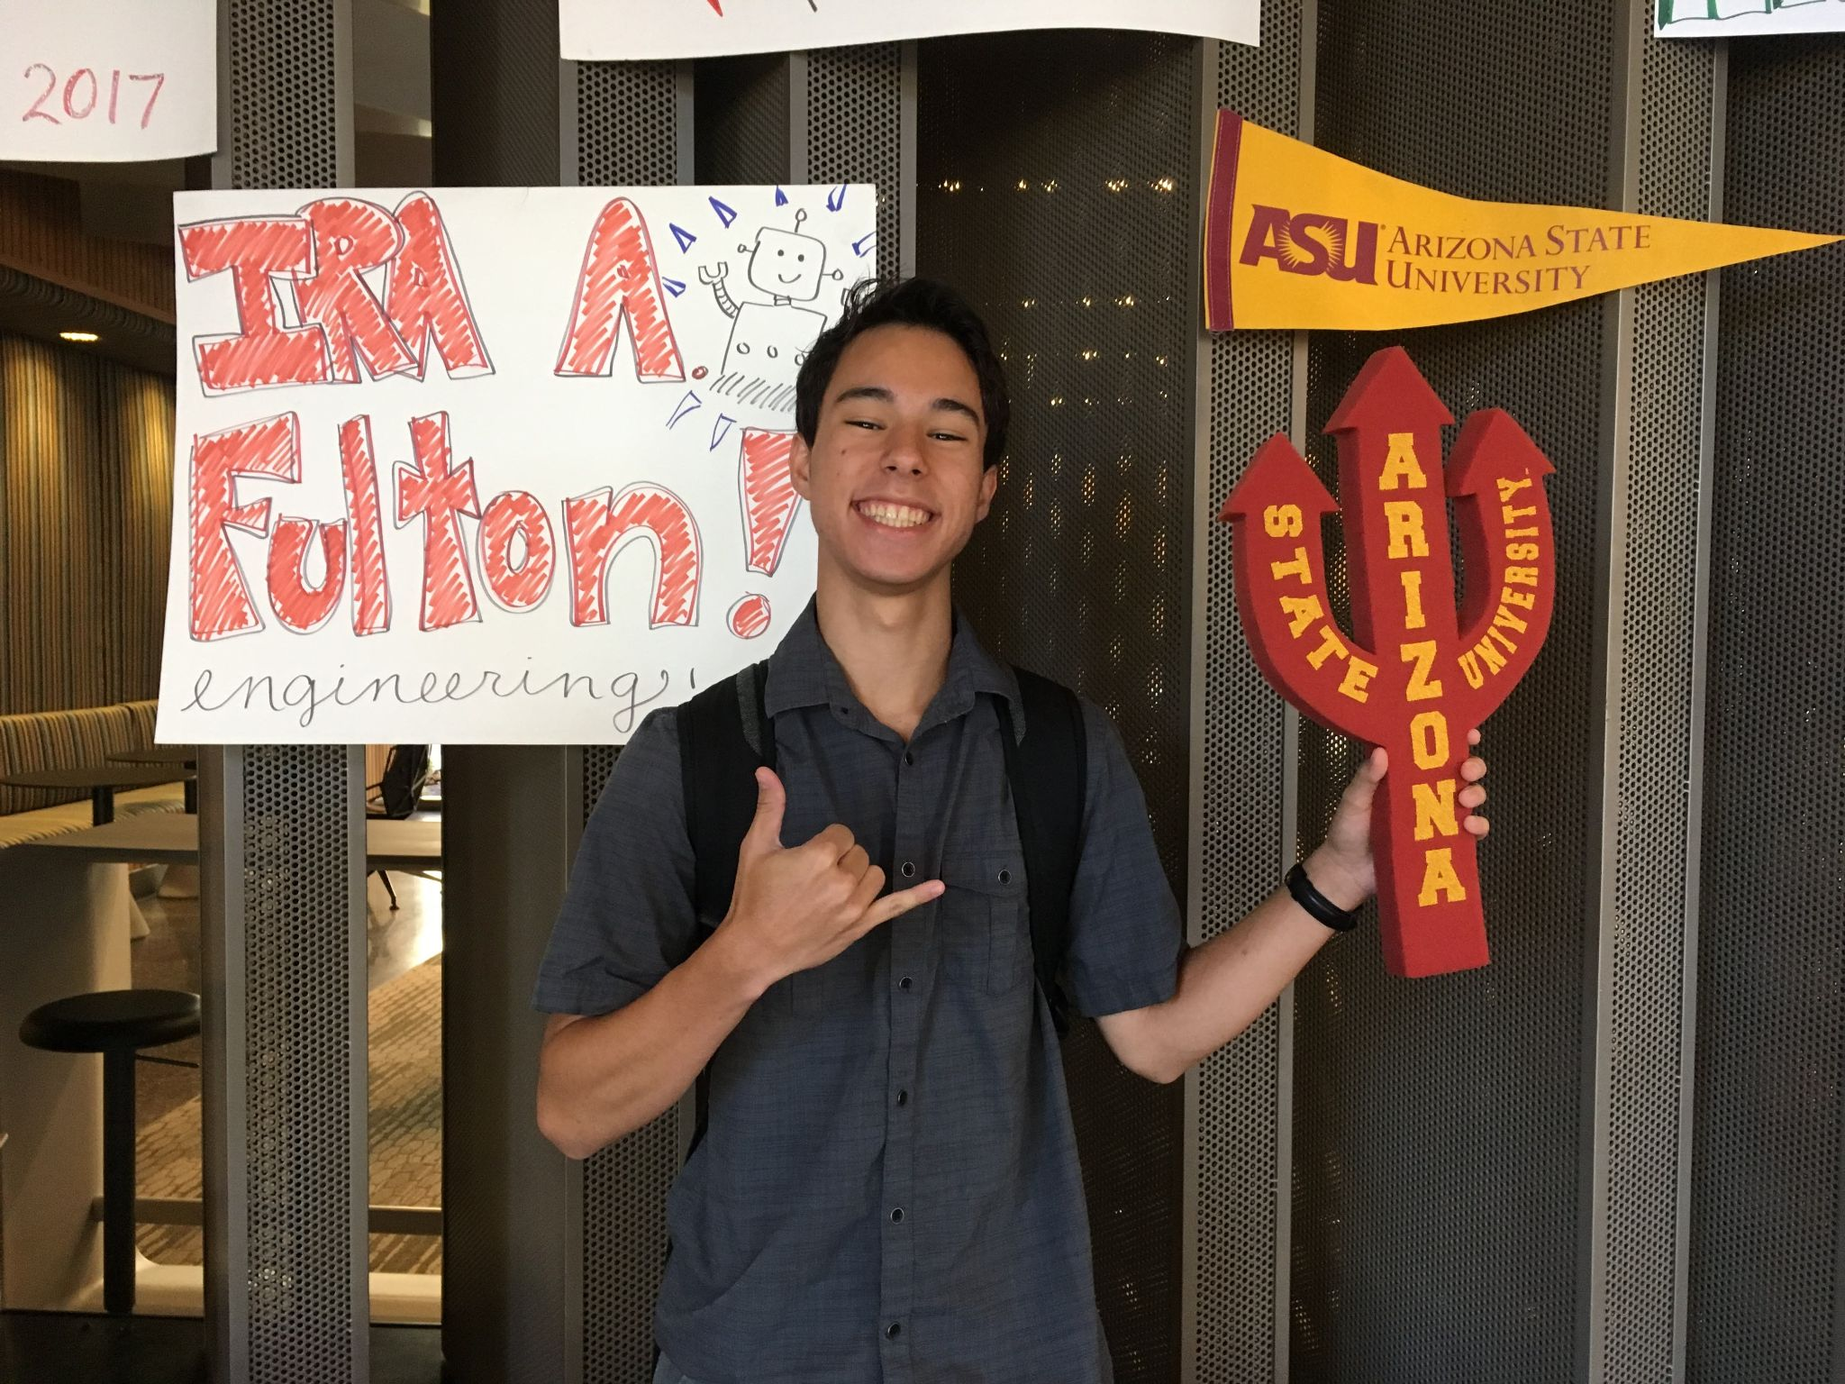
Your CTF Relationship Guide

Slide 11
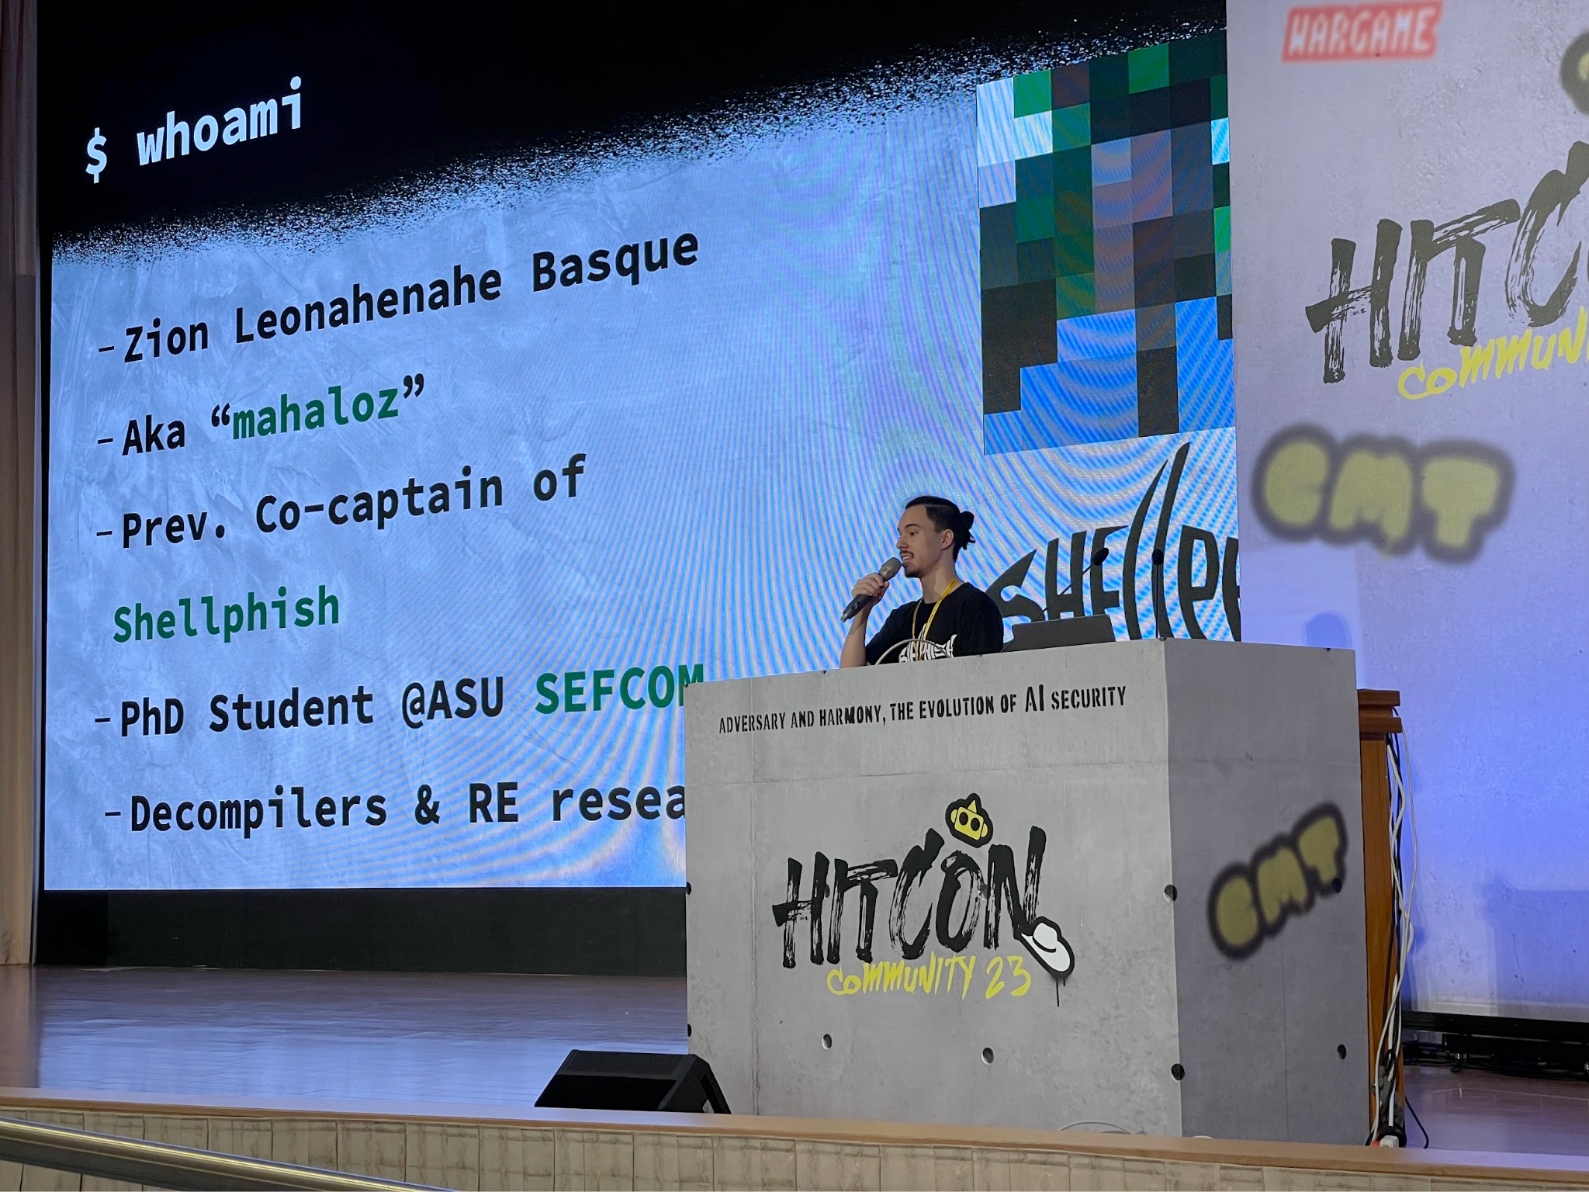
Your CTF Relationship Guide

Slide 12
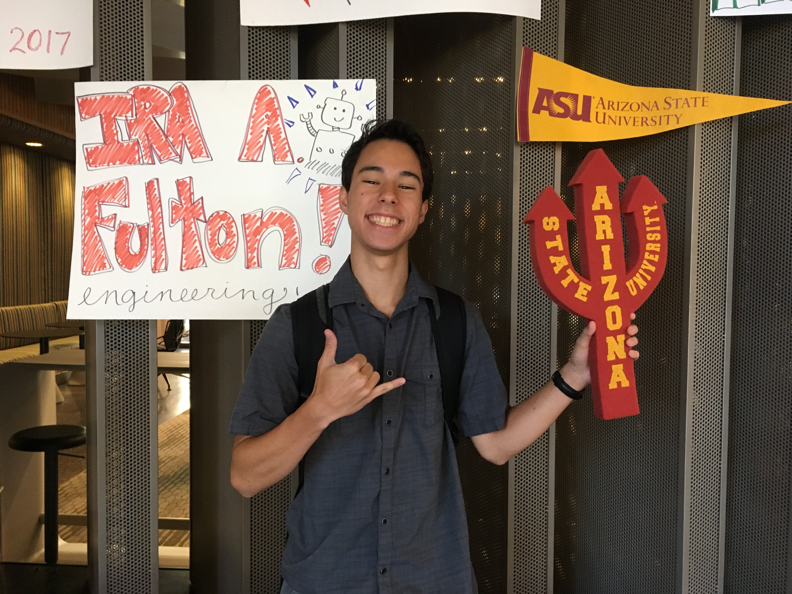
We All Start Somewhere

Slide 13
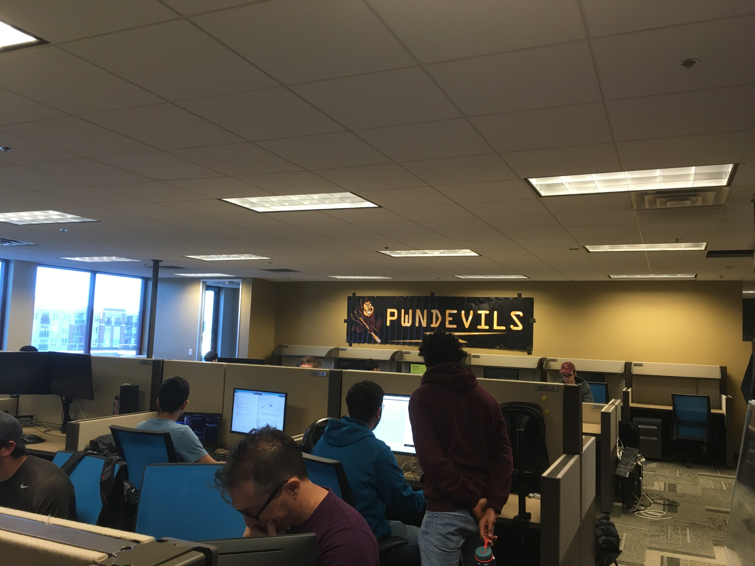
Finding a Partner (CTF Team)

Slide 14
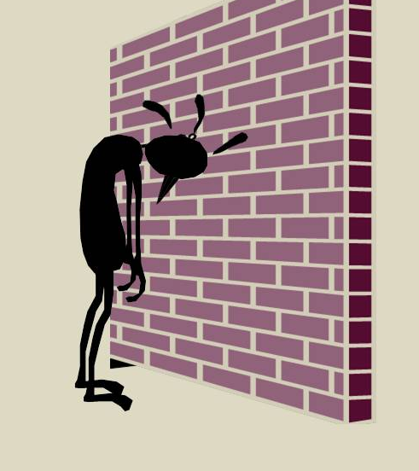
Committing to Your Relationship
Crazy weekdays! 3 hours, 2 days a week (training)
Crazy weekends! 48 hours of CTF (Friday - Sunday)
Lots and lots of losing

Slide 15
Committing to Your Relationship
“For my entire first year of CTFing, I never captured a flag myself”
A Famous CTFer

Slide 16
Committing to Your Relationship
“For my entire first year of CTFing, I never captured a flag myself”
A Famous CTFer - mahaloz

Slide 17
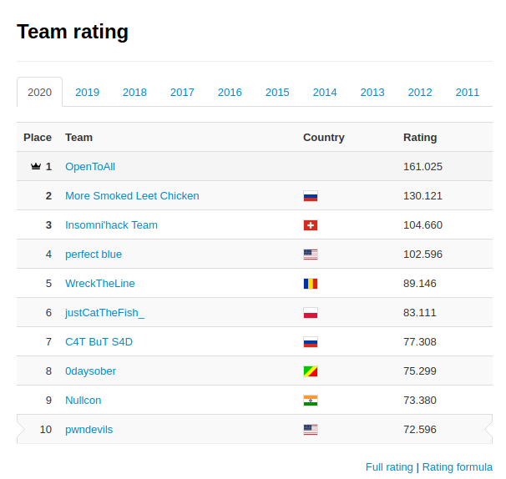
Reaching for the Top

Slide 18
Becoming Shellphish

Slide 19
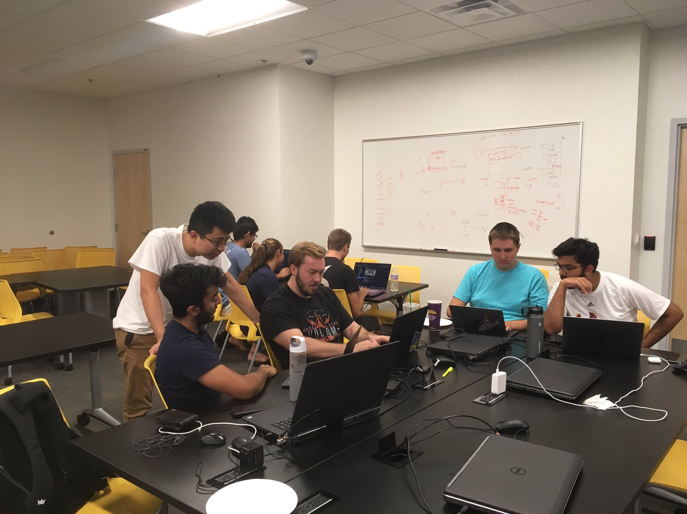
Insights for Others
The wall eventually breaks
It breaks easier, when you work with others who’ve done it already

Slide 20
Managing Your Relationship
(CTF Team)

Slide 21
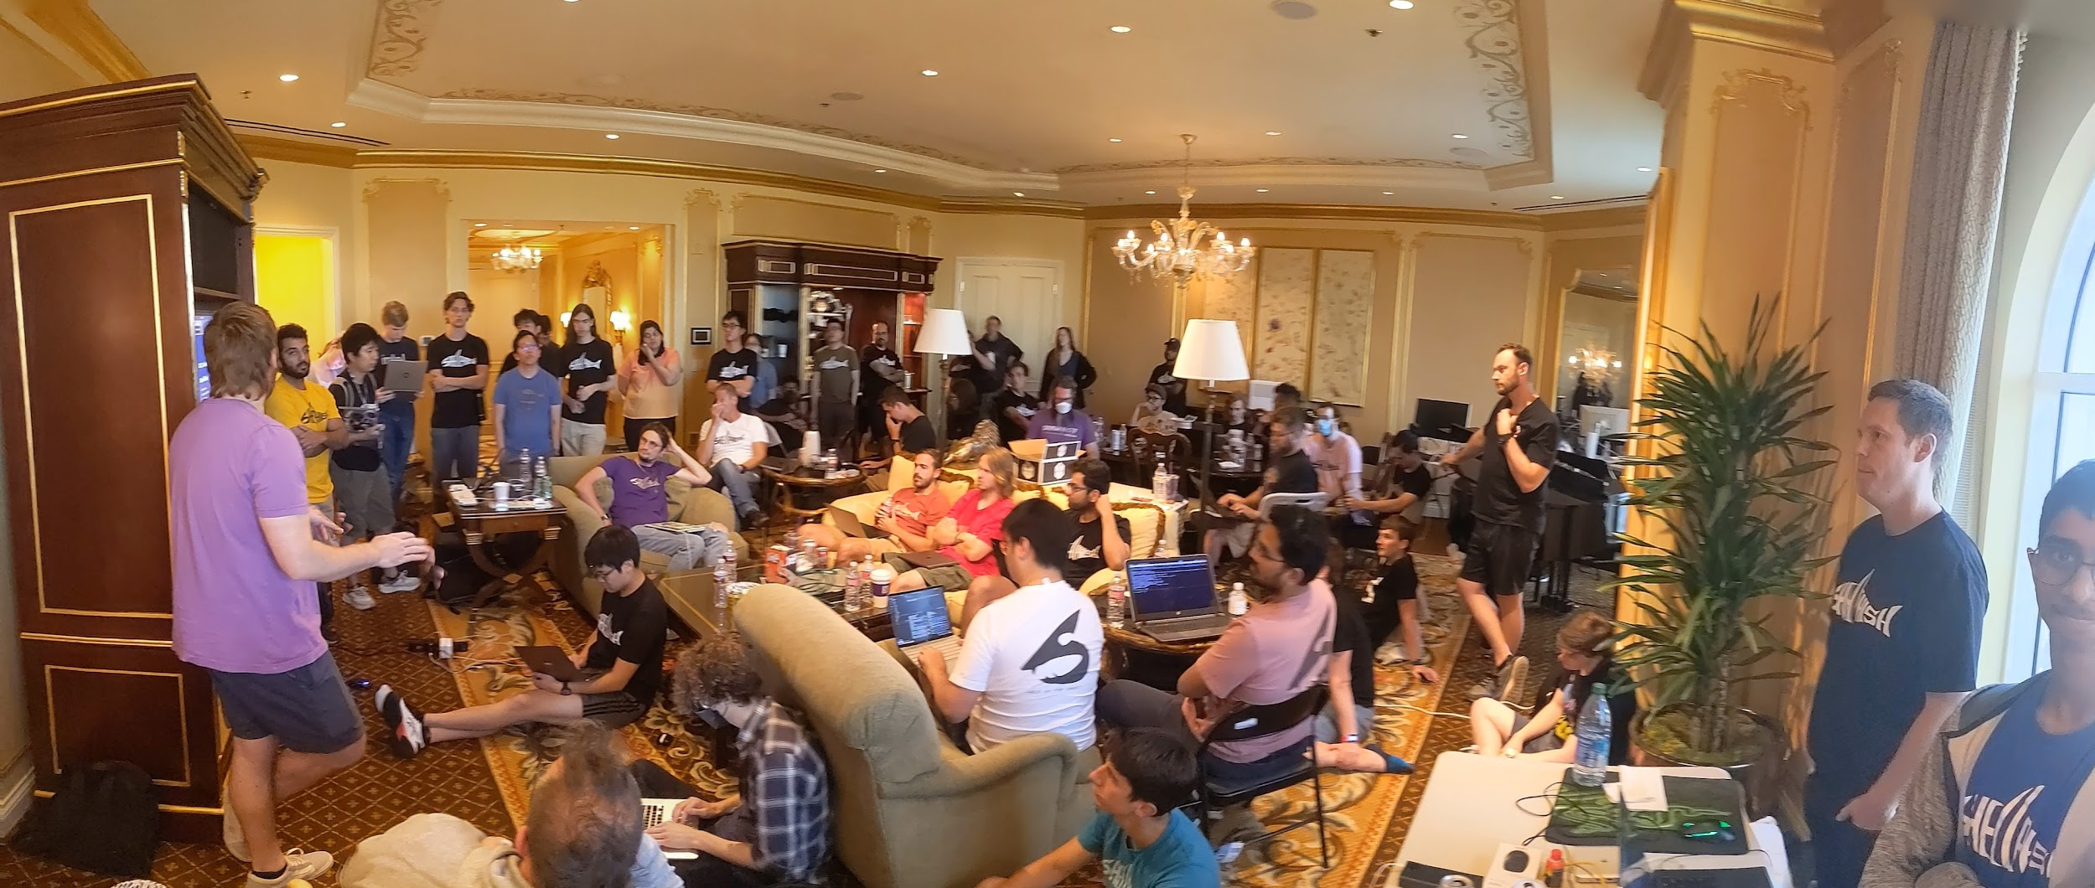
Big Teams Got Big Problems

Slide 22
Setting (some) Boundaries Helps
Four Basic Roles

Slide 23
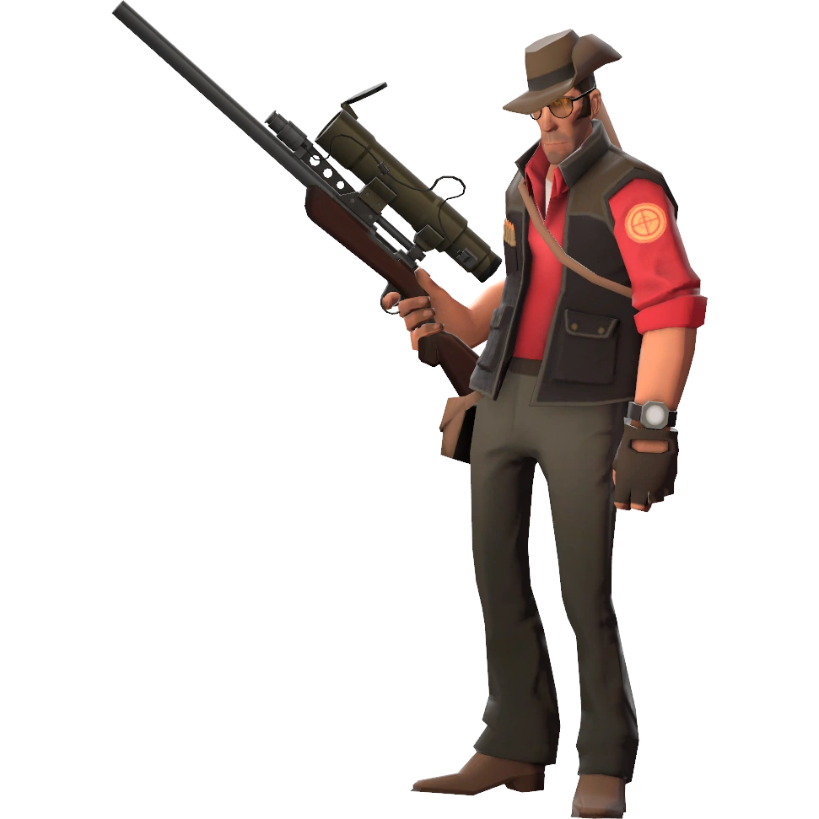
CTF Role: The Captain(s)
Max 3 of them
Generally knows about every challenge active
Calculates risk/reward when to pull people off challs
Forces challenge hosts to sync
Good under pressure

Slide 24
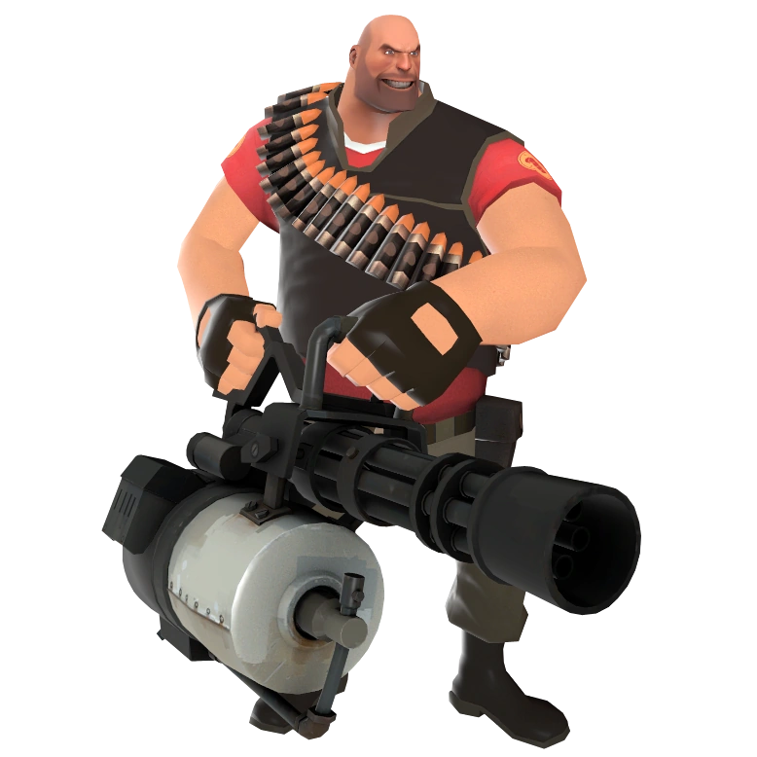
CTF Role: The Challenge Host
Technically strong person, communication can be mid
Stays on a challenge until it is retired
Has the most knowledge in the room on a challenge
Very focused and strong player

Slide 25
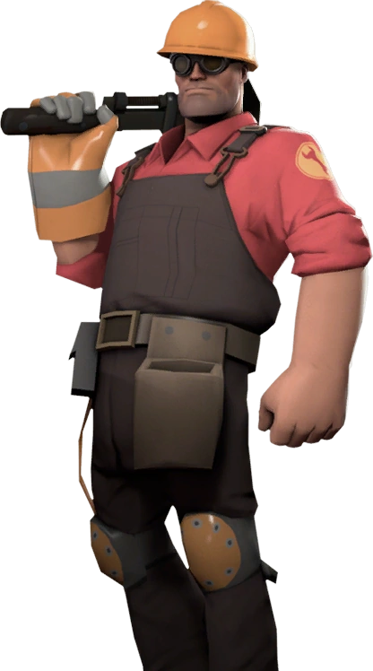
CTF Role: The Engineer
Runs/fixes the tooling during the game
Accepts the fate of having to leave challenges prematurely
In A/D:
Runs the shooter
Runs the traffic interception
Analyzes packets (if board)
Very good at debugging
NOT the strongest CTFer on the team

Slide 26
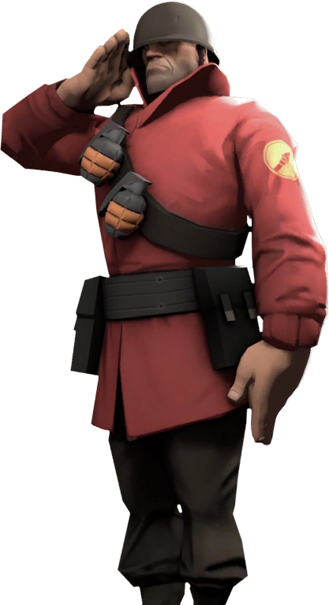
CTF Role: The Hacker
Jumps from challenge to challenge as interested/needed
May have a category specialty

Slide 28
Love is War
And So is a CTF

Slide 29
Prepare for Love and War
Develop any tool you think could be useful
Test all of your tools BEFORE the game
Come well slept/fed
Come with energy drinks
Figure out who your challenge hosts could be
Get hyped?!?

Slide 30
Always Thinking About Your SO
Obsess over the details
Read writeups after the game, resolve the challenge
Always think about ways to spice up the game with automation
Come up with strategies to speed up your hacking

Slide 31
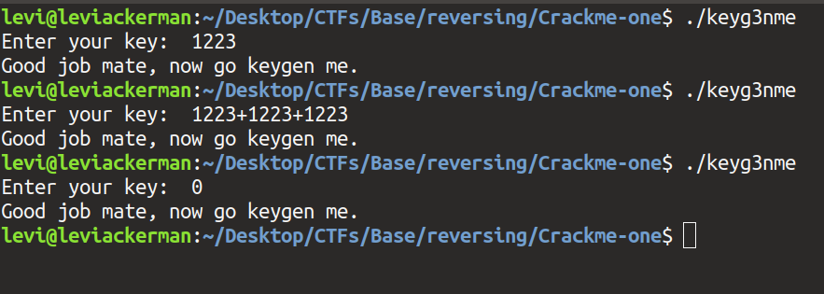

Case Study: angr
Symbolic executor
Deleted “crackme” challenges from CTFs

Slide 32
Share The Love
When possible, share what you’ve learned
It makes you smarter as well

Slide 33
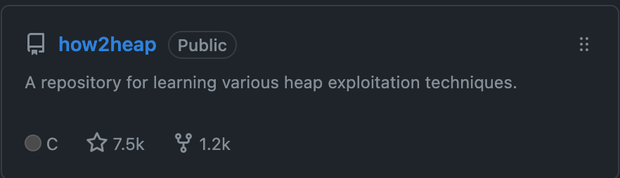
Case Study: How2Heap
Open source manual for heap exploitation

Slide 34
Love is Friendly
The best teams are full of life long friends
Make crazy memories with them
Crazy memory:
I once had to walk down the “strip” in Las Vegas, while at DEFCON, wearing another person's shirt, avoiding our hotel room, and lugging a 20 pound computer in a suitcase called “The Bomb”

Slide 35
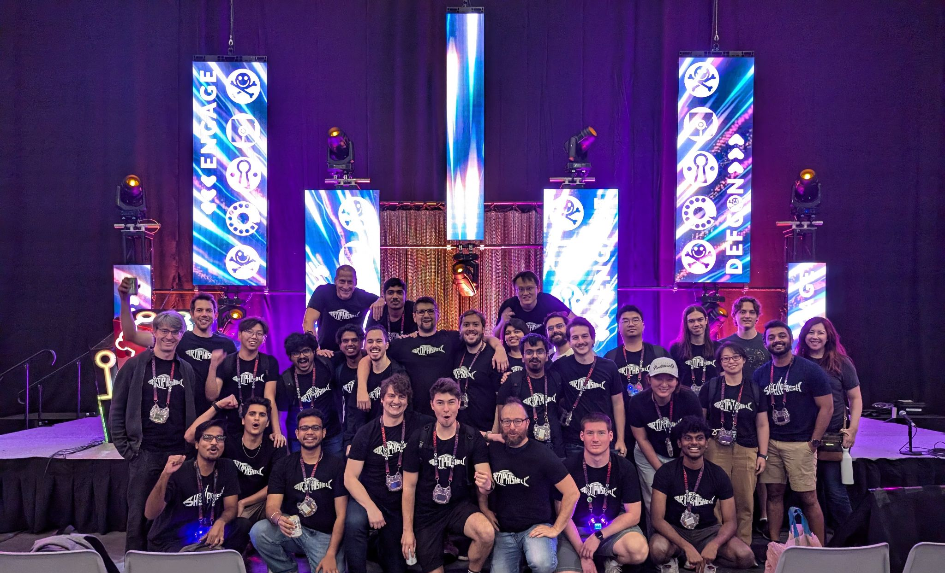
Apply What You Learn Elsewhere
The “CTF Mindset” is a way of life, sometimes it leads to big opportunities
Like winning 2 million dollars in competition built on CTFer work

Slide 36
So, CTFs are cool...

Slide 37
Reality meets media

Slide 38


Slide 39
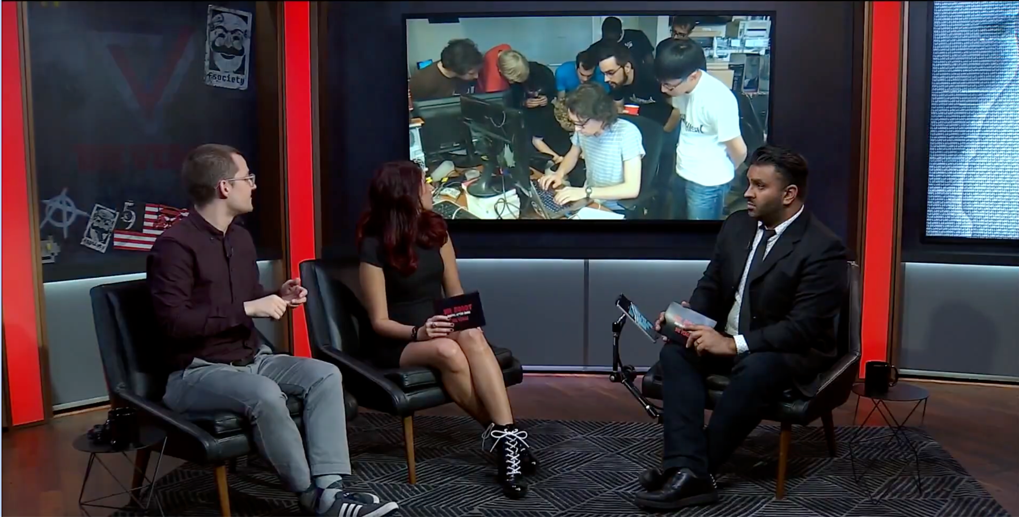

Slide 41
Thanks for Listening
Zion Leonahenahe Basque
@mahal0z
https://mahaloz.re
https://shellphish.net

